Slide 1
Quantized RSS Based Wi-Fi Indoor Localization with Room Level Accuracy
汇报人：任晓琪

Slide 2
隐马尔可夫模型
http://www.cnblogs.com/skyme/p/4651331.html
Notes:
物联网与位置定位服务相关性越来越高，研究者开始评估无线定位技术，例如指纹定位。

Slide 3
Many indoor Location
get sub-meter preciison for grid position
however such accuracy is not necessary
such as conference room identification etc.
Our system
track the mobile user at room level granularity with high accuracy and reliability
not need the prior knowledge of the true scale of the floor plan nor the true coordinate of each reference point (RP) within the room.
the offline labour consumption can be significantly reduced.

Slide 4
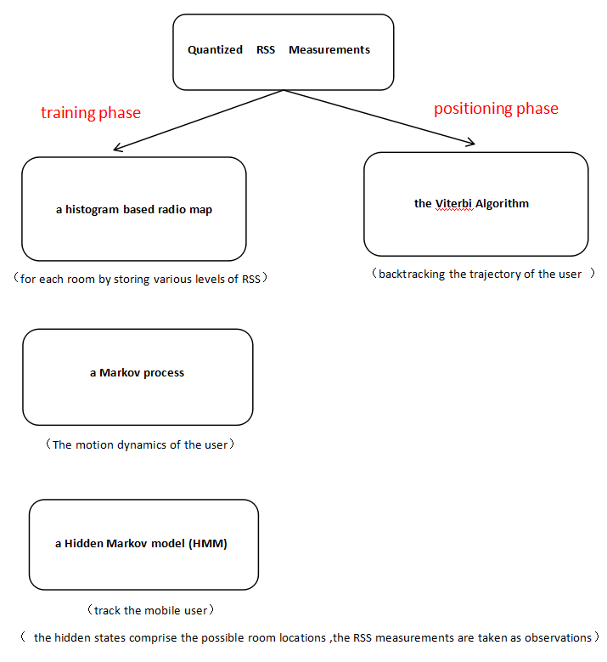

Slide 5
GPS,DWifi,Bayesian filters...
All the systems mentioned above do not take into account the interdependencies among the RSSI measurements at a certain position from the various APs. These interdependencie provide important information about the geometry of the environment
the proposed system employs a joint histogram probability distribution model that exploits the spatial correlations of signal strength measurements collected from various APs based on a multivariate quantized state model.

Slide 6
2.1.1 Data structure
Ap1...k
k
RP 1...M
RSS
RSS
M
cell r
AP1
...
APk

Slide 7
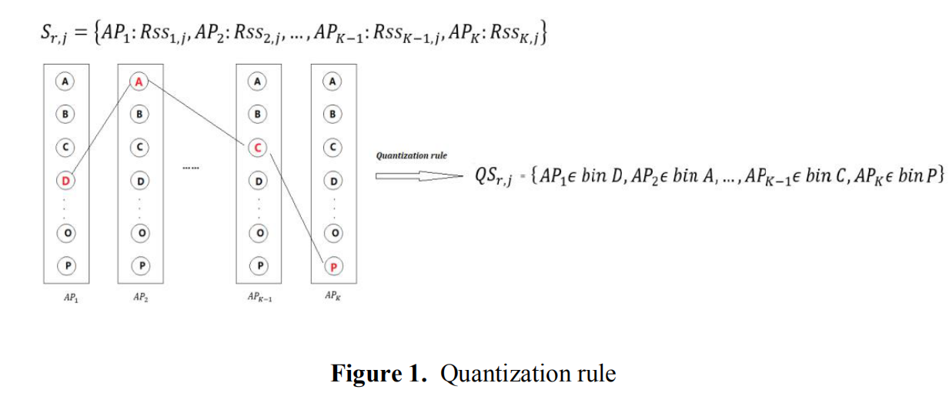
2.1.2 Multivariate quantized RSS

Slide 8
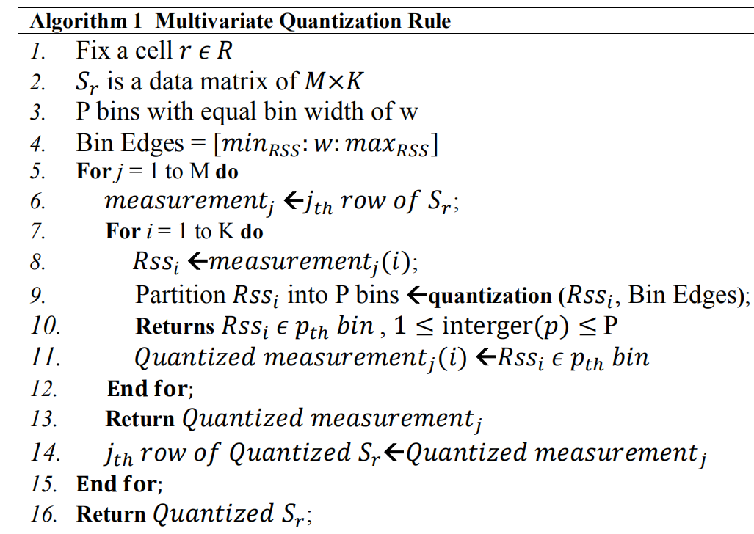

Slide 9
2.1.3 Joint histogram probability
assume that the APs are independent
By considering the interdependence between APs

Slide 10
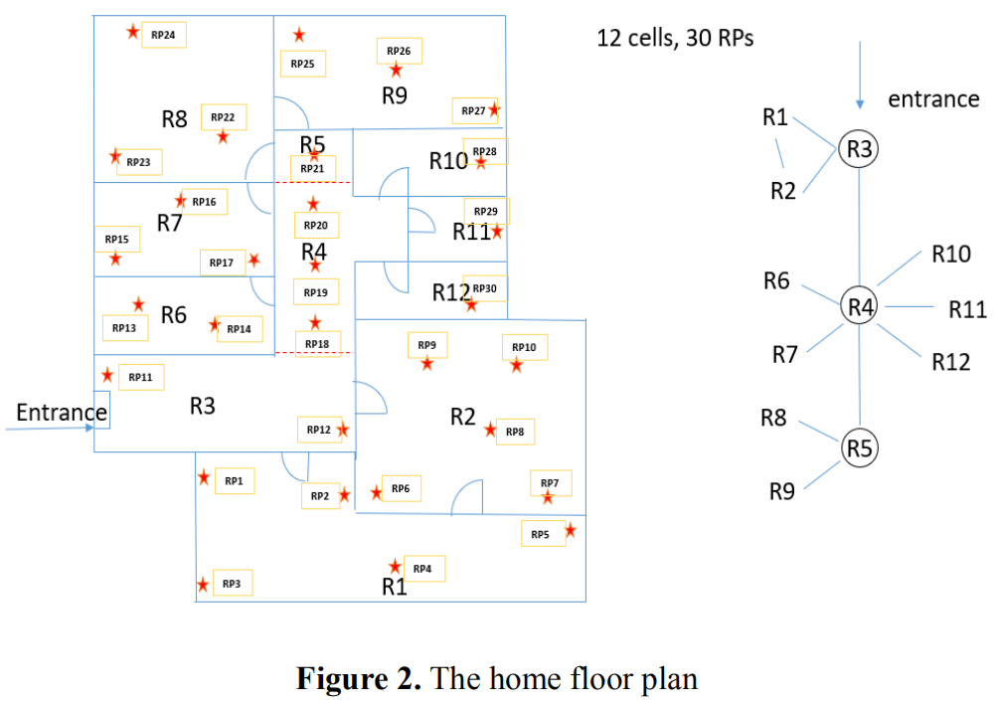
2.2 Building Topology

Slide 11
The segmentation will define the transition matrix in the HMM such that only two adjacent cells would have non-zero transition probability while the transition probability between isolated cells is zero.
the hidden states of the HMM are the 12 cells that enumerate the possible location of the user.

Slide 12
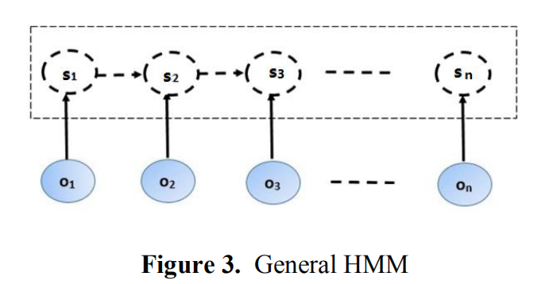
2.3 HMM

Slide 13
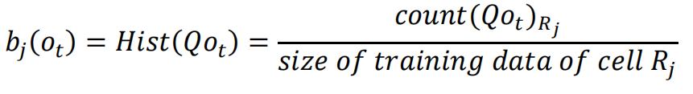

the probability of moving to one of these cells is defined to be 1/n, the probability of moving to other isolated cells is 0
the emission probability is a joint histogram probability based on quantized RSS measurement
the prior state probability

Slide 14
In HMM-based tracking system, the Viterbi algorithm is applied to find the optimal state sequence with respect to the Maximum a posteriori (MAP) criterion given the observation sequence

Slide 15
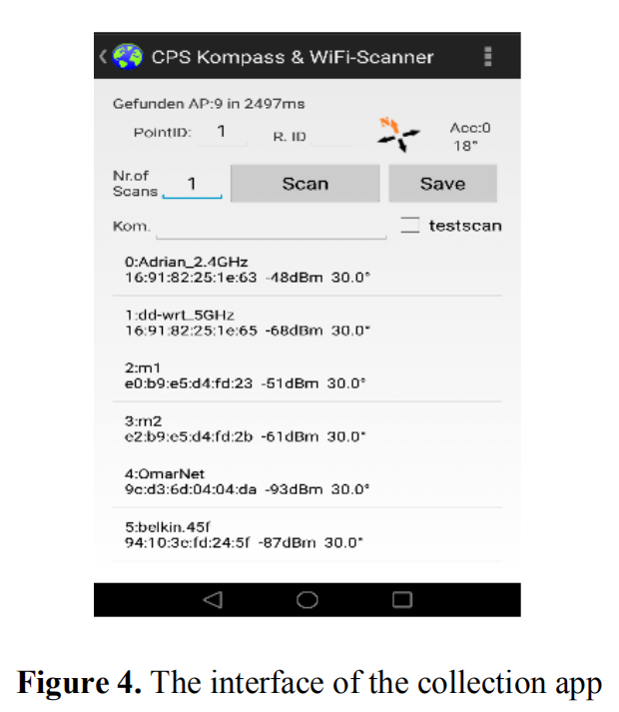
3. Experiments and Results
in a home environment in Melbourne, Australia
an example of the total number of visible APs at RP1 in the first scan is 5, and the corresponding sensed AP MAC addresses and RSS values.

Slide 16
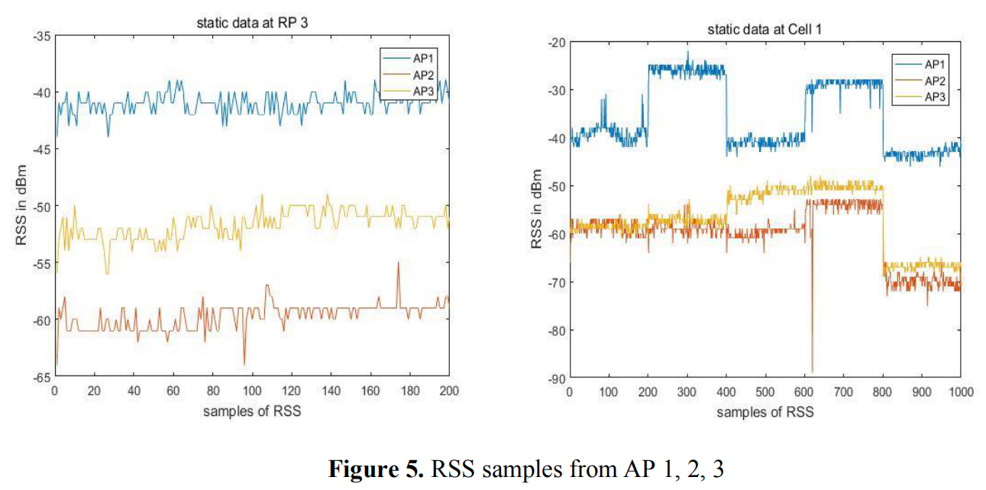
3.1 AP Interdependence Analysis

Slide 17
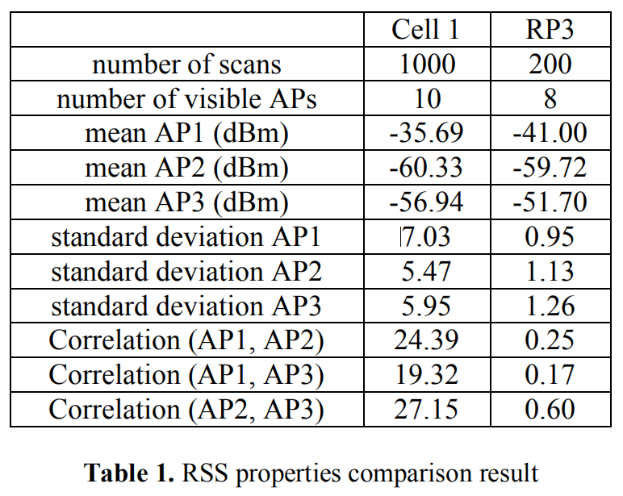
The RSS samples are more stable during the collection time and have smaller variations at RP 3 compared with the cell 1 data.
The correlations between pairs of APs at RP3 are small 0.6 . However, the correlations between pairs of APs become large after fusing 5 points’ data that we can no longer assume the RSS samples from the visible APs are uncorrelated, which also explains the proposed algorithm does not invoke the assumption of AP independence.

Slide 18
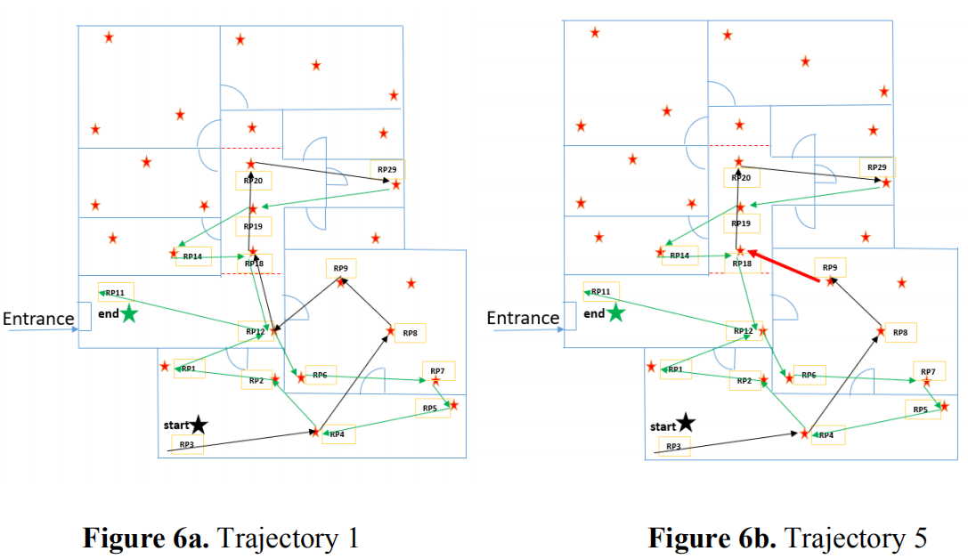
3.2 Static Test

Slide 19
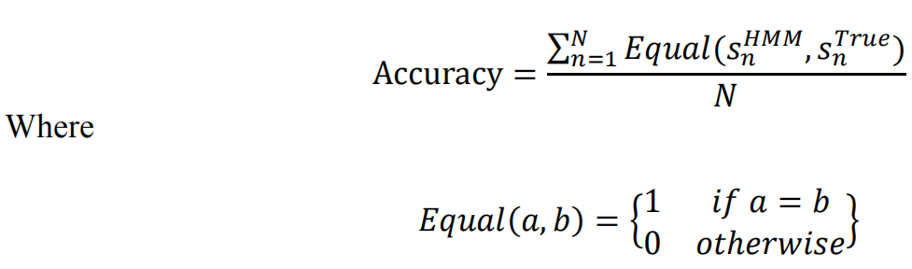
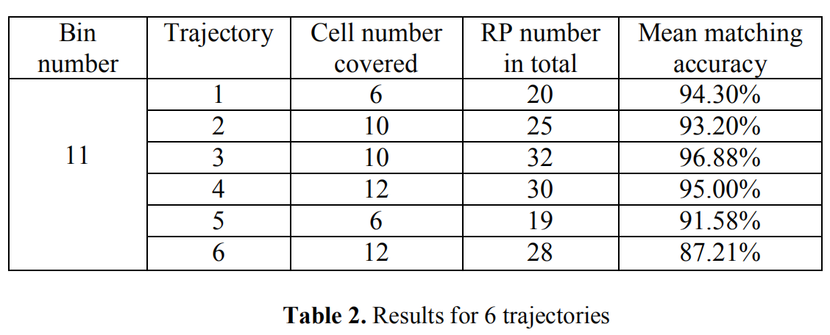
the bin number P=11

Slide 20
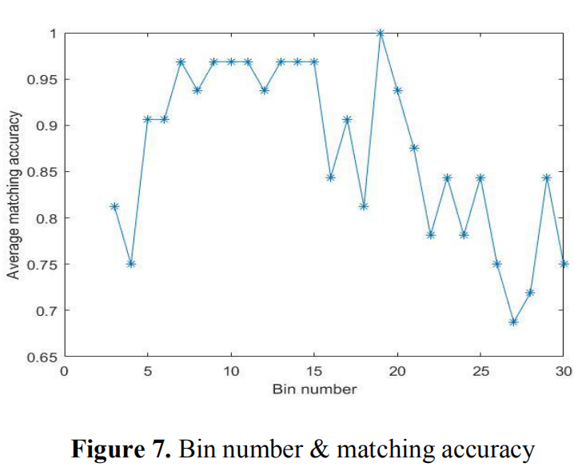
The accuracy for the proposed joint histogram probability is also affected by the selection of the bin numbers.
Finding an optimal bin number is still an open question.

Slide 21
4. Discussion
Based on our analysis, currently we can get reasonable accuracy based on a limited number of measurements, there are the two possible reasons:
1. The APs can only be fall into several fixed bins but not all possible combinations.
2. The proposed algorithm gives coarse estimation rather than grid estimation, that we localize a mobile user to a cell instead of a point

Slide 22
5. CONCLUSIONS
By considering the correlation between pairs of APs, the proposed joint histogram probabilistic fingerprinting algorithm can achieve as high as 96.88% matching accuracy and an overall of 94.85% successful matching accuracy with a limited number of training data.

